Slide 1
Comm 100A
Communication, the Person and Everyday Life
Summer Session II
Week 4a - August 26, 2019

Slide 2
Today’s Class:
1. Review
2. This week: personhood & disability in everyday life
3. Adam, Adam, Adam and Adam (and the LD that acquired him)
4. Looking ahead:
-- review for final on Wednesday
-- next Wednesday – final in class, BRING A BLUEBOOOK

Slide 3
Personhood and disability in everyday life
Just as Butler showed that successful GENDER PERFORMANCE is a necessary attribute for social personhood, this week’s readings suggest that ABILITY (cognitive, verbal, physical) is also tied in with personhood.
-- How have scientists and educators understood disability?
-- identifying traits
-- isolating traits
-- testing for these traits and whether they correlate with physical causes
-- treating these traits
-- How do McDermott and Varenne want us to understand disability?

Slide 4
Medical model of disability
-- disability as physical disorder, located in the body/mind of an individual
-- medical problem
-- positive: dealing with it is legible as social good
-- positive: resources for support via federal, medical & educational institutions
-- negative: specific dis-order “spreads” with the creation of a category/identity
-- stigma
--”Adam’s problem with reading was spreading to other areas of his life.” (p.26)
-- negative: hides the social conditions in which a dis-order becomes understood as such
-- negative: conflating compensatory behaviors/symptoms with “core” symptoms

Slide 5
Social model of disability
-- disability as social disorder, located between individual capacities and social norms
-- social problem
-- ”Adam” article is an example of this approach
-- “Adam could not be disabled on his own.” (p.26)

Slide 6

Maxine Hong Kingston
  我
I
-- The Woman Warrior: Memoirs of a Girl Among Ghosts (1976)
Mixes memoir and Chinese folk stories to examine Chinese-American experience
Describes a moment in an American classroom, unable to read the word “I” out loud

Slide 7
Adam in four situations: “Adam Adam Adam and Adam”
I
I
I
I

Slide 8
Adam in four situations: “Adam Adam Adam and Adam”
As the world got harder, more artificial, or socially threatening, the less well Adam performed and the more he was noticed, documented and remediated.” (p.30)
Everyday life
After-school clubs
Classroom work groups
One-to-one tests

Slide 9
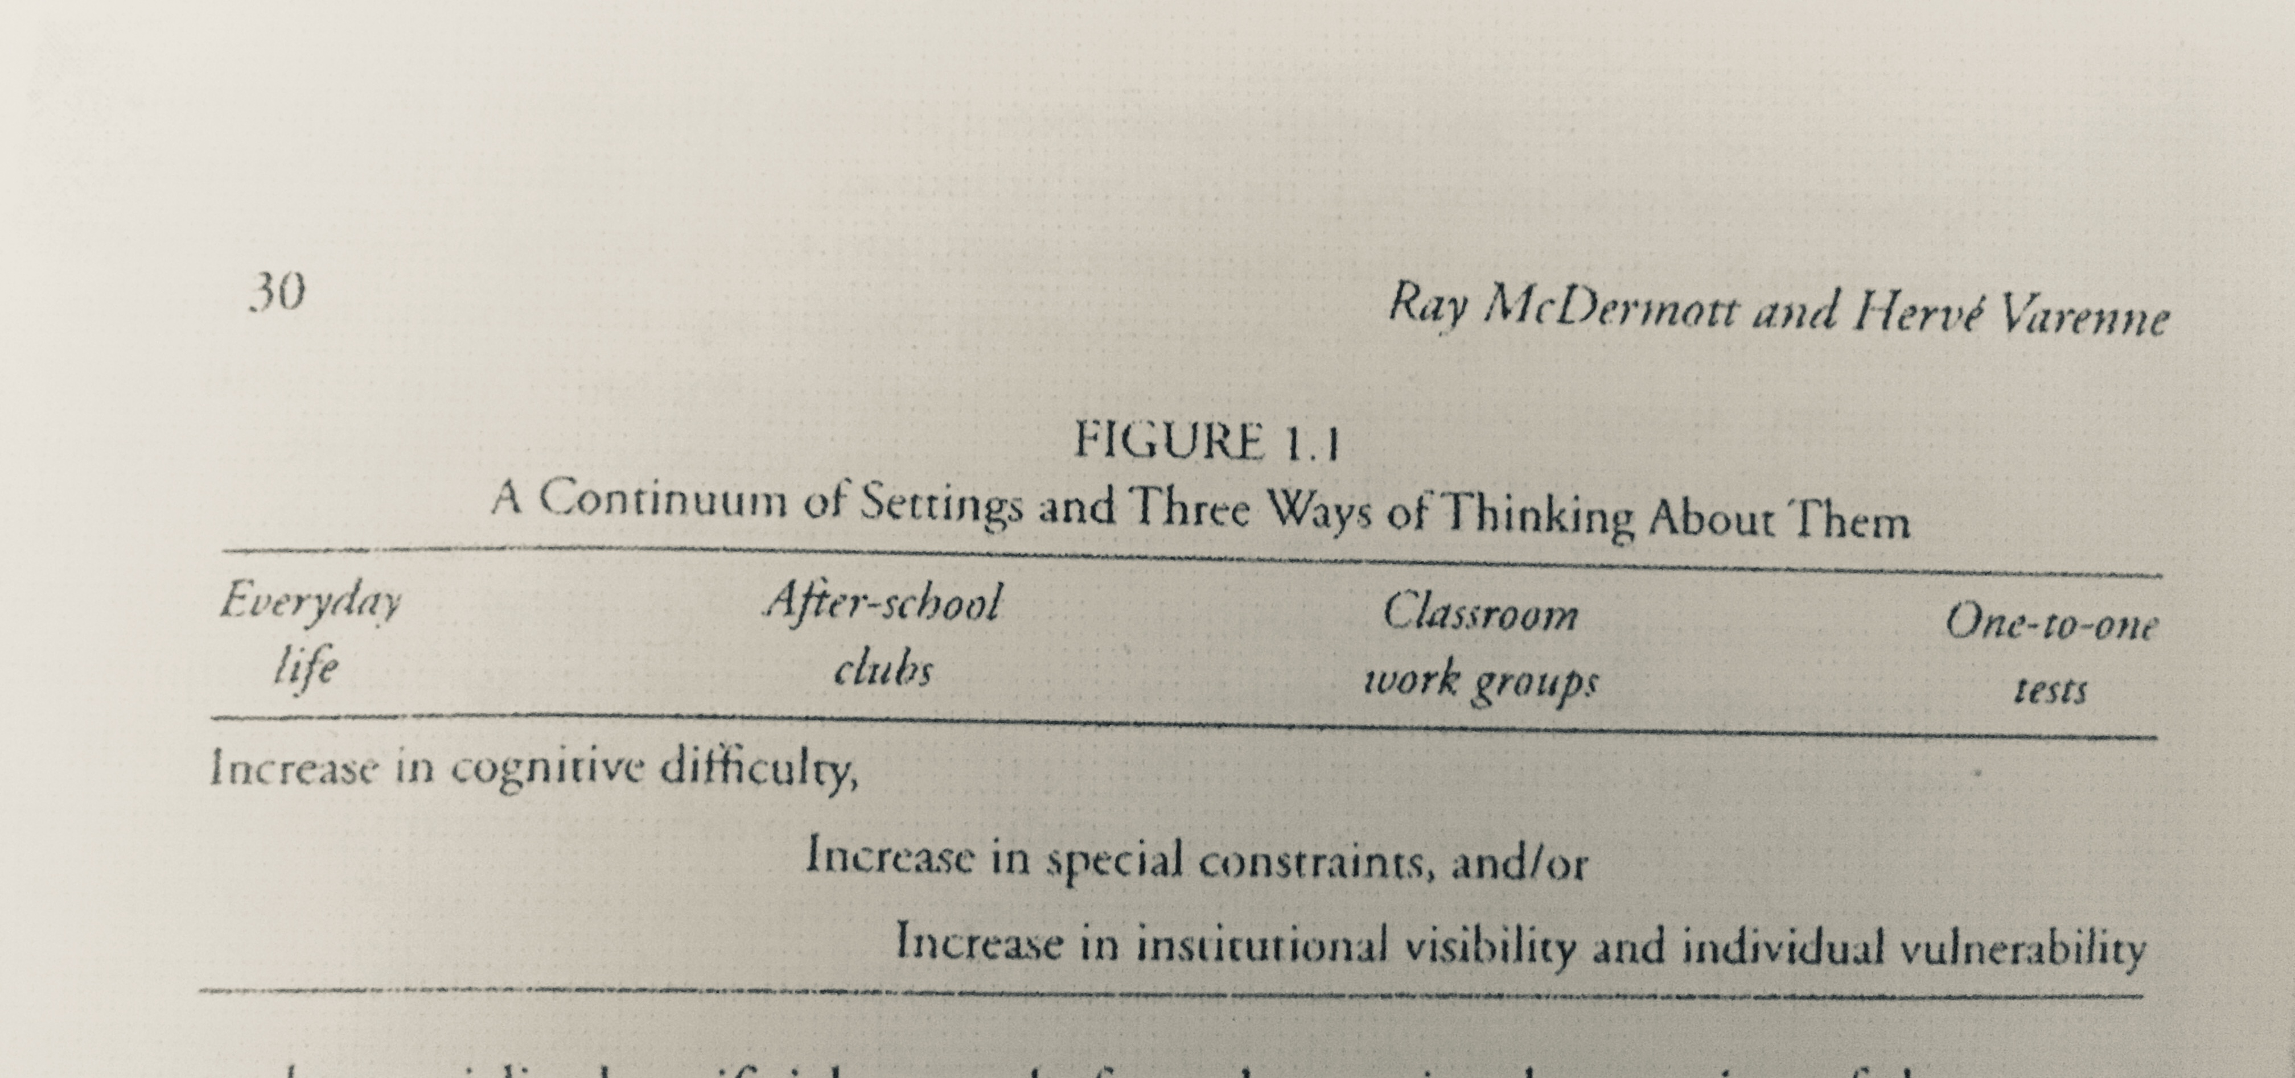
Adam in four situations: “Adam Adam Adam and Adam”
As the world got harder, more artificial, or socially threatening, the less well Adam performed and the more he was noticed, documented and remediated.” (p.30)
Everyday life
After-school clubs
Classroom work groups
One-to-one tests

Slide 10
Adam in four situations: “Adam Adam Adam and Adam”
“The formal organization of the testing session was designed to produce the most neutral and objective circumstances for Adam to reveal his true unique individual self, the culture’s ’objective’ version of Adam’s 我.” (p. 29)”
One-to-one tests
p. 28-29

Slide 11
Adam in four situations: “Adam Adam Adam and Adam”
“While Adam was in the test setting, all behavior was relevant to only one thing: the revelation of whether he was Learning Disabled.” (p. 29)
One-to-one tests
p. 28-29

Slide 12
Adam in four situations: “Adam Adam Adam and Adam”
As the world got harder, more artificial, or socially threatening, the less well Adam performed and the more he was noticed, documented and remediated.” (p.30)
Cooking club
“pisgetthi”
p.31
Reading workshop in class
p.31-32

Slide 13
Are they saying he doesn’t have a LD? (not exactly)
How can we help? (a tricky goal)
“His situation invites sympathy, and such descriptions as we have given are generally used to move readers to some action…The problem, our problem as educators of educators, lies in determining the direction of movement. [Many education theories] proclaim they ‘focus on the needs of individual children so they can become all they can be,’…a noble but easily misguided sentiment…because a critique of the direction taken is often interpreted as a critique of the need to move.” (p.37)
“As we work at identifying someone as a child in need, as we develop means to help others identify him, it is easy to stop considering the actual, active, alive child who handles his problem resourcefully, even in crying.” (p. 38)

Slide 14
How do these authors take a situated approach to Adam?
Recall our conversations about methods for situated analyses!
(phenomenology, psychoanalysis of the social, performativity, conversation analysis)
ETHNOGRAPHY:
-- Authors spend 1 year with Adam the children at this school
They become part of the children’s life-worlds: the worlds, cultures and communities that they themselves experience.
-- They are participant-observers, both participating in community practices at the school and describing & analyzing them through their participant-based understanding. This situated participant-observation approach is foundational for ethnography.

Slide 15
Adam was acquired by a Learning Disability
“On it’s own, the test setting revealed little about the full complexity of Adam’s life, but it did use his behavior to highlight the specifics relevant to a cultural portrait of disability…It is our point that the trait LD was not his; it belonged to the test, its developers and interpreters, and the school systems that had no choice but to take it seriously.” (p.29)
This is an example of challenging universal categories of knowledge in favor of a situated approach! Why does this matter for a person like Adam?

Slide 16
This week’s essay question
Using examples from both Roth and McDermott & Varenne, describe how categories used to identify and treat disabilities can create unintended trouble for the people they diagnose. Again, using arguments and examples from both authors, describe how one might take a situated approach to understanding people with disabilities.

